Slide 2
Security Threat Model Analysis and Protection Practice in Edge Computing Scenarios
魏欢Huan Wei, HarmonyCloud
鲍玥Yue Bao, Huawei Cloud

Slide 3
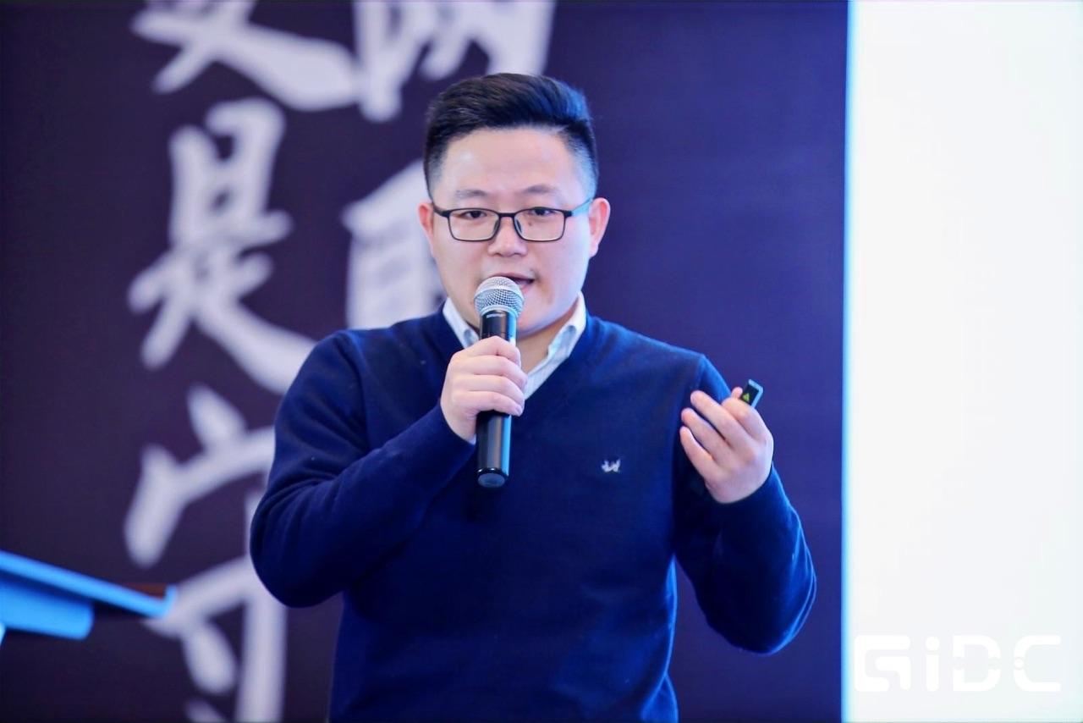

About us
Huan Wei
- CNCF Ambassador
- KubeEdge TSC
- Senior Director, HarmonyCloud
- Github: @huanwei
Yue Bao
- KubeEdge Maintainer
- Huawei Cloud Software Engineer
- Github: @Shelley-BaoYue

Slide 4






Edge Computing
Home
ACC
AGG
Metro
Enterprise
~50km
1~5ms
50~200km
5~10ms
eNodeB
>200km
>20ms
Nearside Edge
City Edge
Regional Edge
Cloud
EDGE
Cloud Services
Cloud Services
MEC
MEC
MEC
Millions
Hundreds-Thousands
Tens- Hundreds
Tens
Typical Apps
V2X, AR/VR, AI
AI Inference
vCDN, AR/VR
Rendering, Video transcoding
AI Training , Big Data
AI Training/Inferencing, Video transcoding

Slide 5

















The KubeEdge Project
Flexible quality inspection
OCR
Facial Recognition
Behavior Analysis
…
KubeEdge - EdgeCore
KubeEdge - CloudCore
Device
Management
Edged
Meta Manager
Cloud - Edge
Coordination
CloudHub
DeviceController
EdgeController
EventBus
DeviceTwin
EdgeHub
Data Access
The first Cloud Native Edge Cloud Computing OSS Project
Open Governance, connecting Cloud Native and Edge Computing Ecosystem
7,600+ stars, 2,100+ forks on GitHub
1500+ contributors (350+ code committers) from 100+ organizations
Edge Computing scenarios oriented, designed for edge-cloud collaboration
Consistent experience of Applications, Resources, Data, Devices, etc. Collaboration between cloud & edge

Slide 6
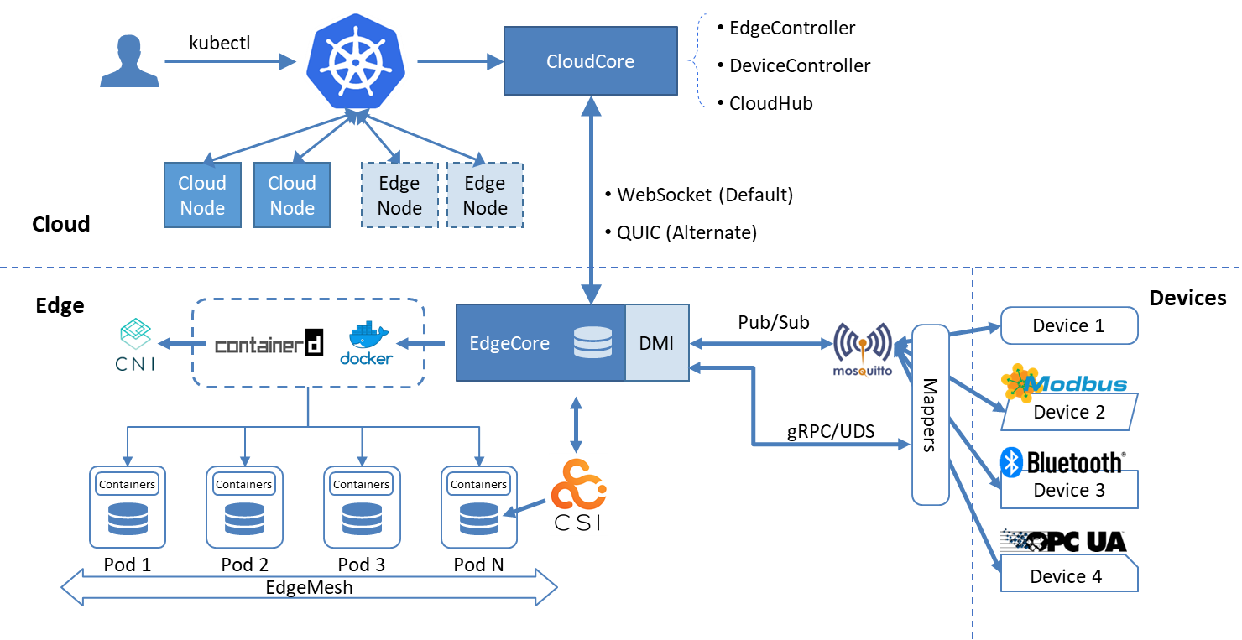
KubeEdge Architecture
Seamless Cloud-Edge Coordination
Edge Autonomy
Low Resource Readiness
Simplified Device Communication
Open Ecosystem

Slide 7
Security Challenge
Security challenges in cloud-native edge computing span across devices, networks, data, applications, operations, identity management, and compliance, requiring a comprehensive security approach to ensure the overall system security.
Edge Devices: Often located in uncontrolled environments, making them vulnerable to physical attacks and unauthorized access.
Network Security: Networks on the edge and between cloud and edge are susceptible to various network attacks such as DDoS and data theft.
Data Security: Edge devices often process sensitive and private data, so ensuring the confidentiality, integrity, and availability of this data is essential.
Application Security: Cloud-native applications deployed at the edge may have vulnerabilities like injection flaws and cross-site scripting, requiring thorough application security testing and remediation.
Operational Security: Edge environments are complex to manage, necessitating automated and standardized operational processes to ensure system security and reliability.

Slide 8
KubeEdge Security

Slide 9
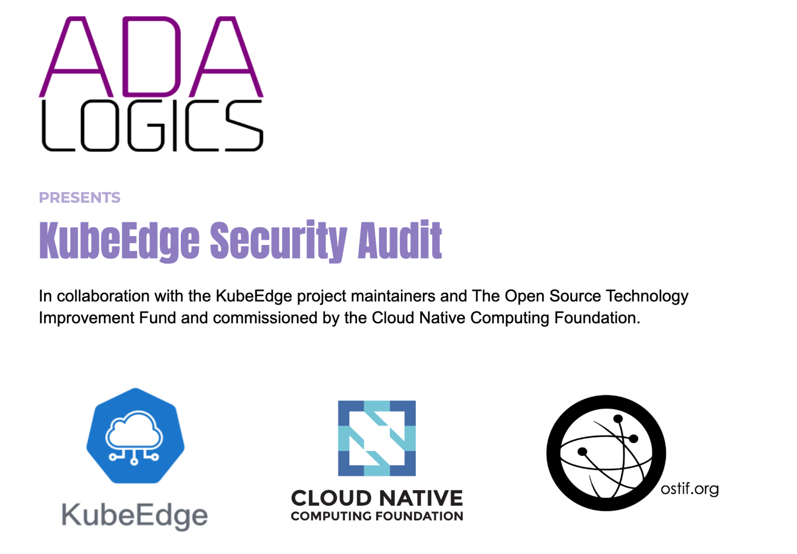



KubeEdge Security
One of the first CNCF Project integrating with Fuzzing
https://www.cncf.io/blog/2022/06/28/improving-
security-by-fuzzing-the-cncf-landscape/
One of the First CNCF project reaching L3 of Supply Chain Levels for Software Artifacts (SLSA)
Source, Build and Common All reached L4
KubeEdge Full Audit Report
https://github.com/kubeedge/community/tree/master/sig-security/sig-security-audit/KubeEdge-security-audit-2022.pdf
KubeEdge Threat Model And Security Protection Analysis
https://github.com/kubeedge/community/blob/master/sig-security/sig-security-audit/KubeEdge-threat-model-and-security-protection-analysis.md

Slide 10
KubeEdge Security Threat
01
02
03
External Attacks
Internal Attacks
Supply Chain Security
Attackers initiate attacks from outside the system. At the component boundaries of the system, traffic access between different trust levels, making attacks more likely to occur.
Attacks caused by internal administrators or operations personnel’s misoperation, such as deploying malicious applications, issuing dangerous configurations, etc.
Supply chain security risks mainly occur in the security of third-party dependent libraries, software build, and release processes.

Slide 11
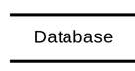
External Attacks —— STRIDE Threat Model
Draw a data flow diagram composed of external entities, systems, database and data flows, as well as trust boundaries, to analyze the six types of threats that each element may face.
Threat | Desired property | Example
Spoofing | Authenticity | Impersonating another users account
Tampering | Integrity | Modifying information
Repudiation | Non-repudiability | Denying modification behavior
Information Disclosure | Confidentiality | User information leakage
Denial of Service | Availability | DDOS causing website unavailability
Elevation of Privilege | Authorization | Elevating a regular user to an administrator
Customer
request
response
Trust Boundary
write
System
read

Slide 12
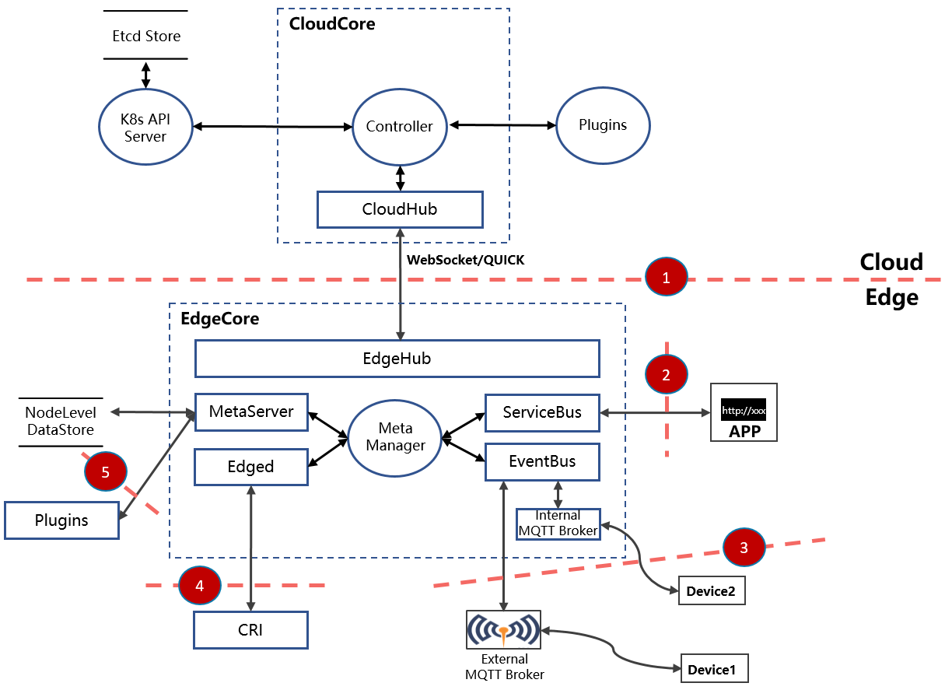
Threat Model Analysis
Threat ID 1: Connection between CloudCore and EdgeCore
Security Enhancement:
Implement certificate-based mutual authentication to ensure secure communication
Regularly refresh edge node certificates to prevent expired certificates from being forged and exploited, and establish a certificate rotation mechanism to ensure business continuity
Add node authorization in CloudHub to restrict the operation from edge nodes.
Security Recommendations:
Use at least 2048-bit keys to generate the relevant certificates
Use a trusted and secure CA root certificate.

Slide 13
Threat Model Analysis
Threat ID 2: EdgeCore provides HTTP service on edge site
Security Enhancement:
Expose only on localhost to limit access scope
Disable the ServiceBus that provides HTTP services by default, following the default security mechanism
Security Recommendations:
Limit node access permissions on edge side
Limit the permissions of edge applications and strictly control privileged containers
Strictly verify the legitimacy of the images

Slide 14
Threat Model Analysis
Threat ID 3: EdgeCore provides MQTT service on edge side
Security Enhancement:
Expose only on localhost to limit access scope
Support users to choose a third-party MQTT Broker, in which case security hardening needs to be carried out based on the security policies of the third-party provider
Only support the topics specified by the users to prevent attacks from malicious topics
Security Recommendations:
Limit node access permissions on edge side
Limit the permissions of edge applications and strictly control privileged containers
Strictly verify the legitimacy of the images
Strictly verify the access of edge devices

Slide 15
Threat Model Analysis
Threat ID 4: Edged manages and monitors K8s resources
Security Enhancement:
Only access local trusted paths (CRI remote socket)
Security Recommendations:
Limit node access permissions
Strictly verify the CRI plugin configuration
Threat ID 5: MetaServer provides edge local list-watch capability
Security Enhancement:
Implement certificate-based mutual authentication to ensure secure communication
Use Service Account TOKEN for authentication

Slide 16
Internal Attacks
Internal attacks mainly refer to attacks caused by system administrations or operations personnel making mistakes in operation.
Using malicious images when deploying applications
Opening high-risk configurations
Security Enhancement:
Provide detailed documentation and component parameter configuration guidance for each component, reducing the difficulty of deploy and operation, lowering the risk of operational mistakes.
Components follow the default security rules and provide detailed descriptions of the impact of risky parameters
Security Recommendations:
Perform system security enhancement for edge nodes
Restrict the permission of edge applications and strictly control privileged containers.
Assign fine-grained permissions for system roles.
Promptly update the KubeEdge version to fix security vulnerabilities.

Slide 17
Supply Chain Security
Supply chain security risks occur in the security of third-party dependency libraries, software build and release processes.
Security Enhancement:
KubeEdge community has introduced the SLSA software supply chain security assessment framework, and the overall dimension has achieved L3 rating.
Regularly update third-party dependency libraries to prevent the introduction of security vulnerabilities.
KubeEdge build and release process has been fully automated on GitHub and sign for software packages and images, ensuring the security of the build and release process.
Security Recommendations:
When using KubeEdge released software packages or images, strictly verify them based on the verification files published by the community.
Introduce the SLSA evaluation framework in the user-integrated software environment.

Slide 18
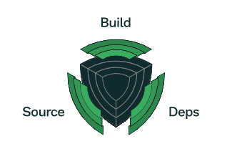
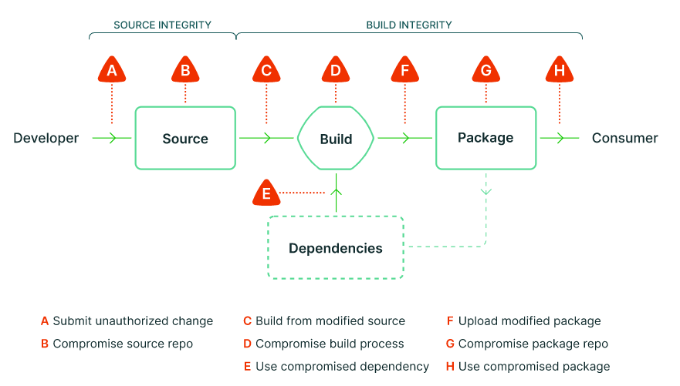
Supply Chain Levels for Software Artifacts (SLSA)
SLSA focuses on three main areas involved in software engineering – build, source, and dependencies.
Source: Ensure the traceability of source code changes, and source code modifications must go through a complete review process.
Build: Ensure the security of the build process, use the correct source code and third-party dependency libraries for the build, and ensure that the source code and build process are not maliciously modified and attacked. Enhance the CI/CD process.
Dependencies: Ensure the security of third-party dependency libraries, strictly verify the correctness of the source when using third-party dependency libraries, and promptly fix security vulnerabilities in dependency libraries.
https://slsa.dev/spec/v0.1/#supply-chain-threats

Slide 19
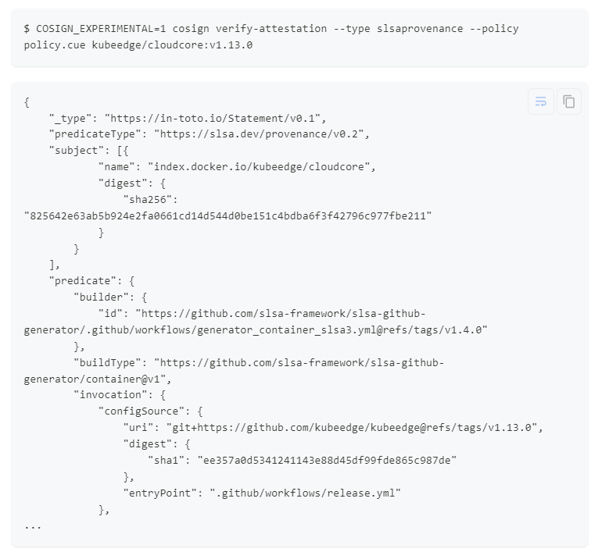
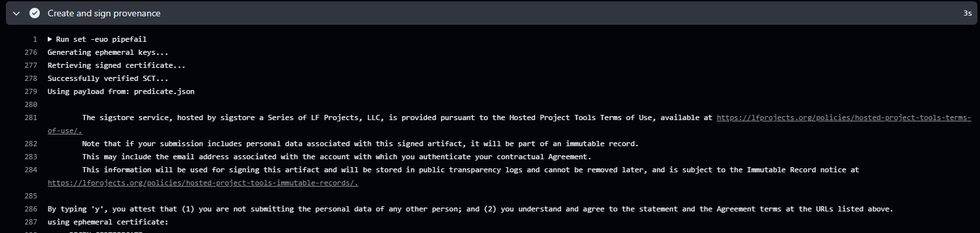
Supply Chain Levels for Software Artifacts (SLSA)
Integrate slsa-github-generator into artifacts release in KubeEdge to achieve SLSA L3
The provenance file of binary artifacts is released with the release software package. The provenance file of a container image is uploaded to the KubeEdge Docker Hub public repository together with the image.
KubeEdge: The 1st CNCF project achieved SLSA L3
Level | Requirements
1 | The build process must be fully scripted/automated and generate provenance.
2 | Requires using version control and a hosted build service that generates authenticated provenance.
3 | The source and build platforms meet specific standards to guarantee the auditability of the source and the integrity of the provenance respectively.
4 | Requires two-person review of all changes and a hermetic, reproducible build process.

Slide 20
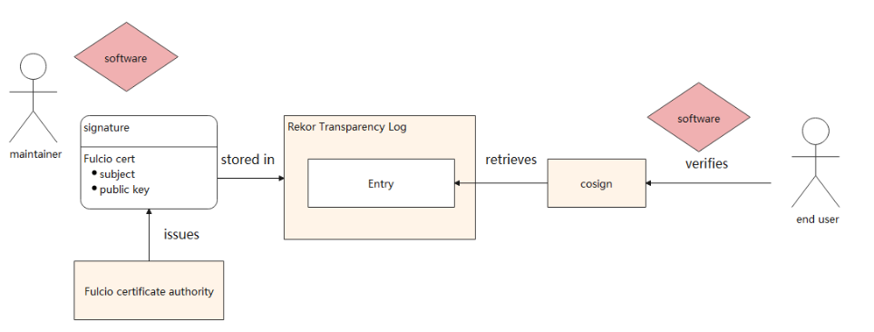
Signing and Working Principles with SLSA
OpenID Connect (OIDC) is used to prove the identity of a workflow to an external service (Sigstore). OIDC is a standard used across the web by identity providers to authenticate users for third parties.
GitHub applies for certificate signing authentication with Sigstore Fulcio through OIDC, and the certificate signing includes code repository, commit hash, trigger and other workflow information of current build, which is saved in Rekor Transparency Log. Users can use the signed certificate as a trusted anchor to verify that the provenance was authenticated and cannot be falsified

Slide 21
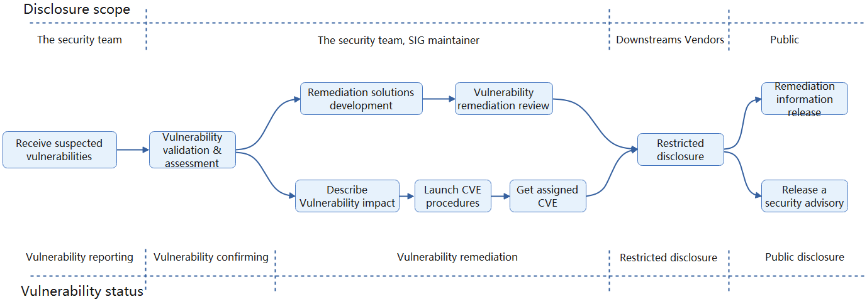

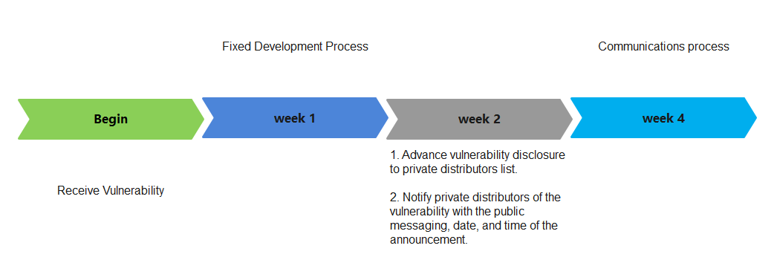
KubeEdge Security Policy and Vulnerability Management
KubeEdge Security Policy and Vulnerability Management
https://github.com/kubeedge/community/blob/master/security-team/SECURITY.md
KubeEdge Team Security quickly respond, analyze, and resolve reported security issues or vulnerabilities.

Slide 22
Security in Edge AI

Slide 23
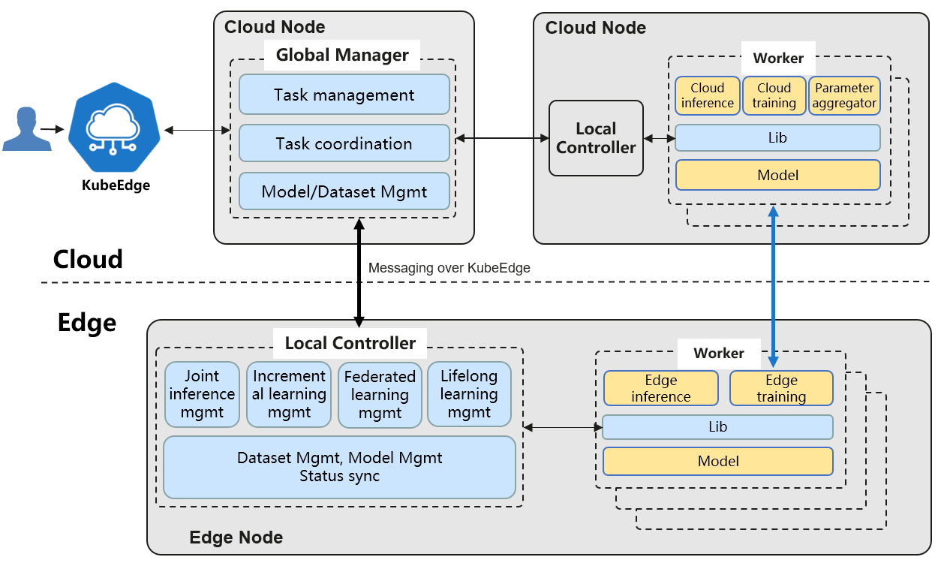
SIG AI: Sedna, Distributed AI collaboration Kit
AI framework fueled by edge-cloud synergy
Dataset and model management across the edge and cloud
Training and inference frameworks fueled by edge-cloud synergy
Joint inference
Incremental learning
Federated learning
Lifelong learning
Open ecosystem
Compatible with mainstream AI frameworks: TensorFlow, PyTorch, Paddle, MindSpore, etc.
Provides extended interfaces for developers to quickly integrate third-party algorithms

Slide 24
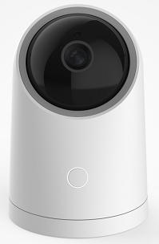
Edge-Cloud Collaboration Federated Learning
Multi-task detection, divide the Non-IID sample set, and cooperate with the cloud to recognize similar tasks
Local training, upload model parameters to the cloud, and cloud runs cross-edge migration + model aggregation algorithms
Isolated data does not leave the edge
Knowledge aggregation produces the model
Edge 1
app
model
Cloud
Aggeration Algo
Labeling
Service
local samples
local incre-training
Algo
models parameters updating
Developers: import the edge AI Lib, develop edge-cloud collaboration federated learning program
Launch the federated learning task, deploy the training program to edge
Edge 2
Labeling
Service
local samples
local incre-training
Algo
Sedna Federated-Learning Service API
app
model

Slide 25




Edge-Cloud Collaboration Federated Learning in Intelligent Industrial Organism
Business Benefits
Sedna
GM
Aggregation worker
Distributed training model performance matched centralized training accuracy
Representation data is unrecoverable when SSIM<0.3, enhancing privacy protection
Edge site computing resource requirements reduced by 50%
Edge-cloud communication traffic reduced by 90%
KubeEdge
Cloud
Edge
Noisy Characterization
Noisy Characterization
Noisy Characterization
Factory in Area A
Factory in Area B
Factory in Area C
Edge Node
Edge Node
Edge Node
Sedna
LC
Sedna
LC
Sedna
LC
Characterization Data Extraction
worker
Characterization Data Extraction
worker
Characterization Data Extraction
worker
Noisy Characterization
Marking Service
worker
Marking Service
worker
Marking Service
worker
Quantitative Characterization
Sedna Lib
Sedna Lib
Sedna Lib
Intermediate Representation

Slide 26



Join Us Making Cloud Native Ubiquitous!
Multi Domain, Multi-Scene, Edge Computing Platform
Make Cloud Native Ubiquitous
https://github.com/kubeedge
https://kubeedge.slack.com

Slide 27
Thank you

